Slide 1
An introduction to Motion Planning
Professor:
Dr. Hossein Rahmani
Students:
Ali Alaei
Sadegh Tabasi
Ehsan MirAbadi
TA:
Arman Jafari

Slide 2
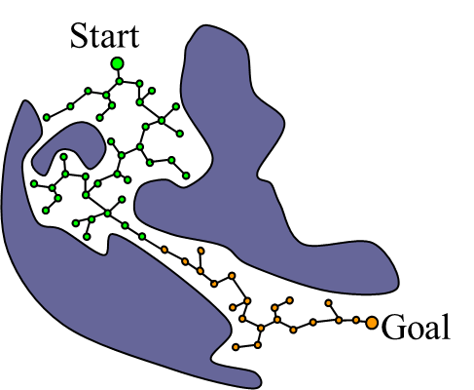
What is motion planning?

Slide 3
Some Usages of motion planning:
Animating digital characters
Video game AI
Self driving cars
Robotic surgery
Biology molecules
Small size robots
…

Slide 4


Inventors of RRT :

Slide 5
What Is RRT ?
A rapidly exploring random tree (RRT) is an algorithm designed to efficiently search nonconvex, high-dimensional spaces by randomly building a space-filling tree. The tree is constructed incrementally from samples drawn randomly from the search space and is inherently biased to grow towards large unsearched areas of the problem.

Slide 6
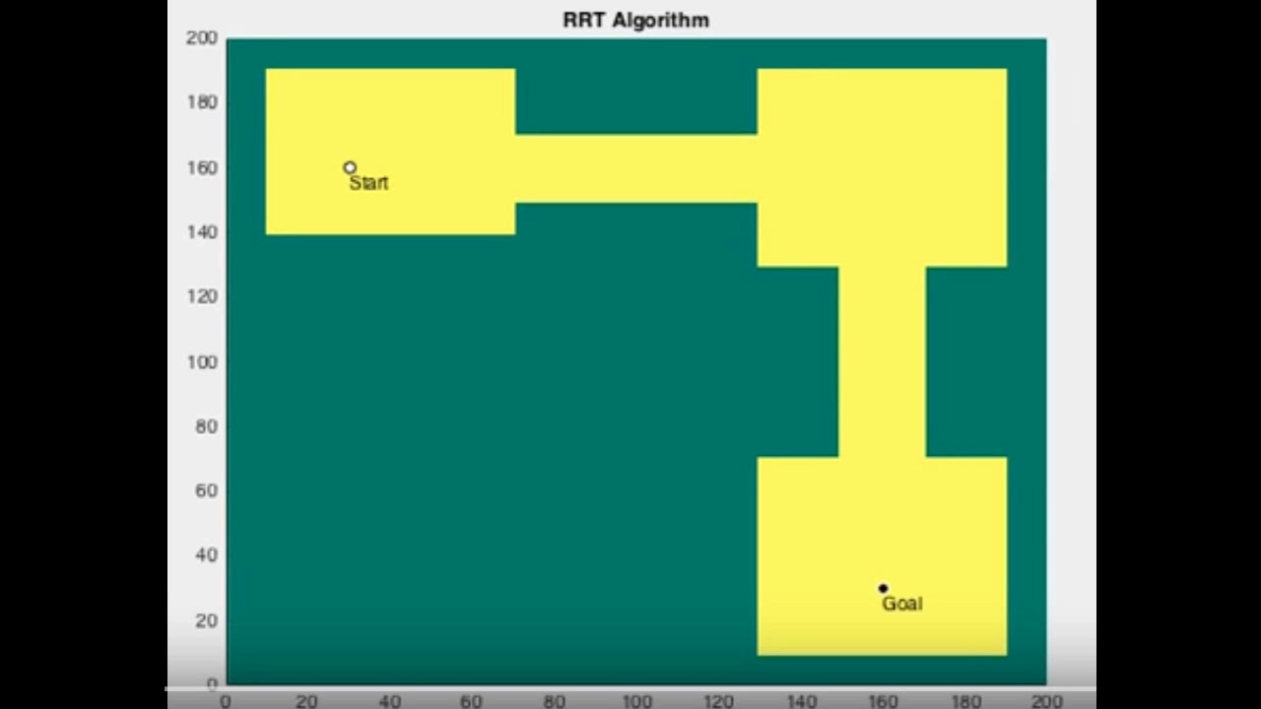
How RRT works :

Slide 7
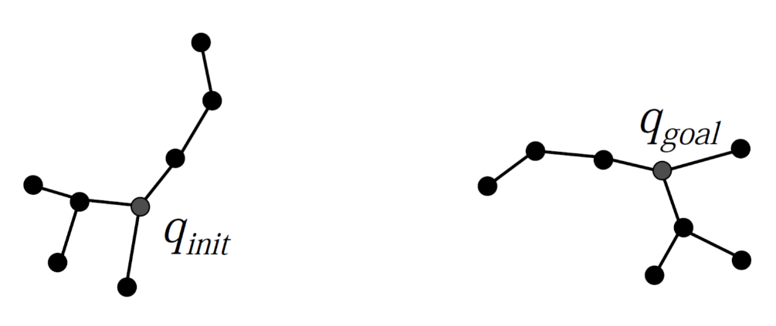
RRT step by step :
1: function RRT(Xinti,Xgoal)
2: T tree(Xinit)
3: run = true
4: while (run) do
5: Xrand getRandomState()
6: Xnearest getNearestNode(T,Xrand,hueristicMode)
7:if isVaidExpansion(Xnearest,Xrand) then
8: Xnew = goTowardNode(Xnearest,Xrand,maxEdgeLength)
9: T.addNode(Xnew,Xnearest);
10: if goalReached(Xnew,Xgoal) then
11: run = false
12: return T

Slide 8
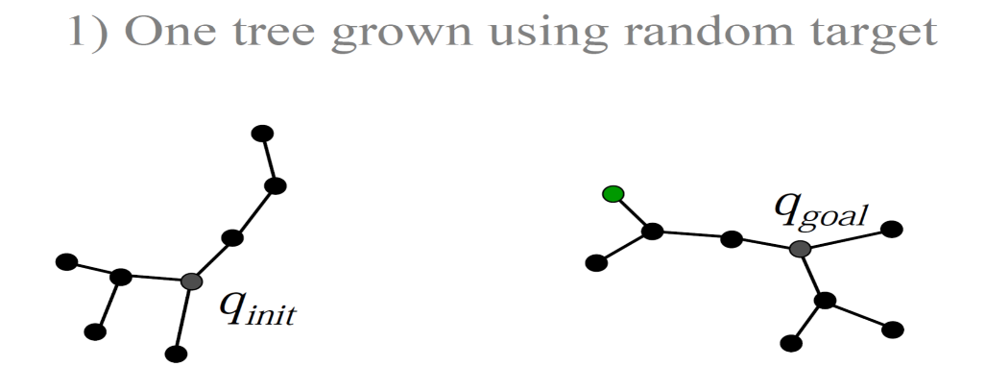
RRT step by step :
1: function RRT(Xinti,Xgoal)
2: T tree(Xinit)
3: run = true
4: while (run) do
5: Xrand getRandomState()
6: Xnearest getNearestNode(T,Xrand,hueristicMode)
7:if isVaidExpansion(Xnearest,Xrand) then
8: Xnew = goTowardNode(Xnearest,Xrand,maxEdgeLength)
9: T.addNode(Xnew,Xnearest);
10: if goalReached(Xnew,Xgoal) then
11: run = false
12: return T

Slide 9
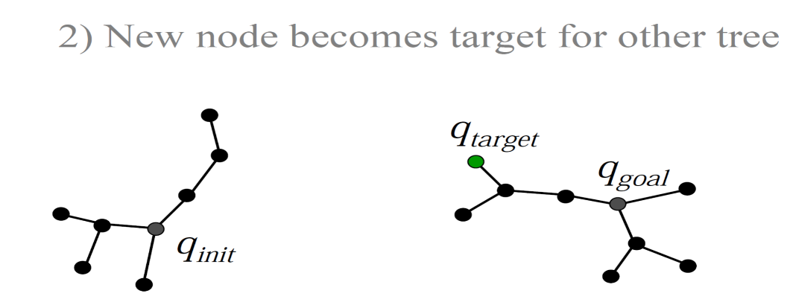
RRT step by step :
1: function RRT(Xinti,Xgoal)
2: T tree(Xinit)
3: run = true
4: while (run) do
5: Xrand getRandomState()
6: Xnearest getNearestNode(T,Xrand,hueristicMode)
7:if isVaidExpansion(Xnearest,Xrand) then
8: Xnew = goTowardNode(Xnearest,Xrand,maxEdgeLength)
9: T.addNode(Xnew,Xnearest);
10: if goalReached(Xnew,Xgoal) then
11: run = false
12: return T

Slide 10
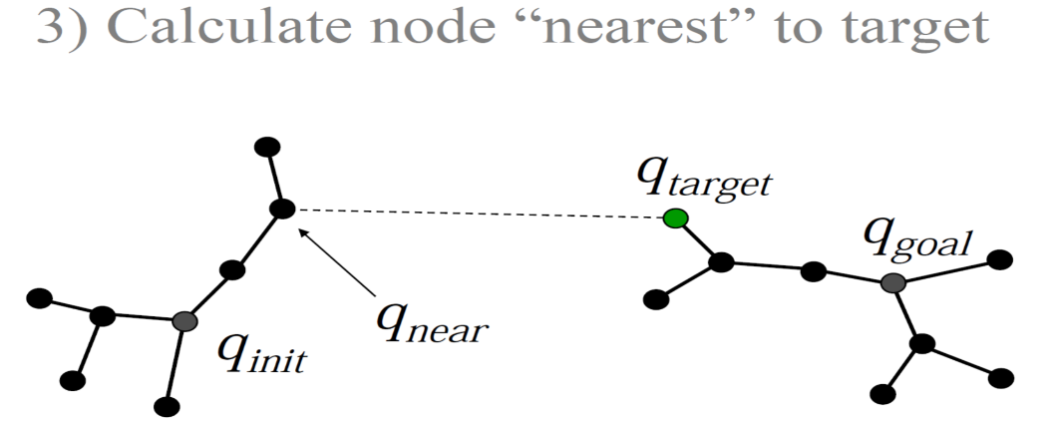
RRT step by step :
1: function RRT(Xinti,Xgoal)
2: T tree(Xinit)
3: run = true
4: while (run) do
5: Xrand getRandomState()
6: Xnearest getNearestNode(T,Xrand,hueristicMode)
7:if isVaidExpansion(Xnearest,Xrand) then
8: Xnew = goTowardNode(Xnearest,Xrand,maxEdgeLength)
9: T.addNode(Xnew,Xnearest);
10: if goalReached(Xnew,Xgoal) then
11: run = false
12: return T

Slide 11
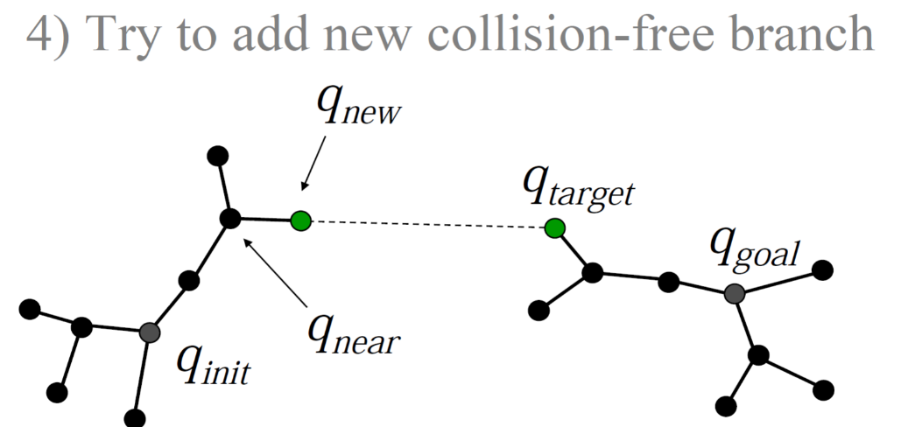
RRT step by step :
1: function RRT(Xinti,Xgoal)
2: T tree(Xinit)
3: run = true
4: while (run) do
5: Xrand getRandomState()
6: Xnearest getNearestNode(T,Xrand,hueristicMode)
7:if isVaidExpansion(Xnearest,Xrand) then
8: Xnew = goTowardNode(Xnearest,Xrand,maxEdgeLength)
9: T.addNode(Xnew,Xnearest);
10: if goalReached(Xnew,Xgoal) then
11: run = false
12: return T

Slide 12
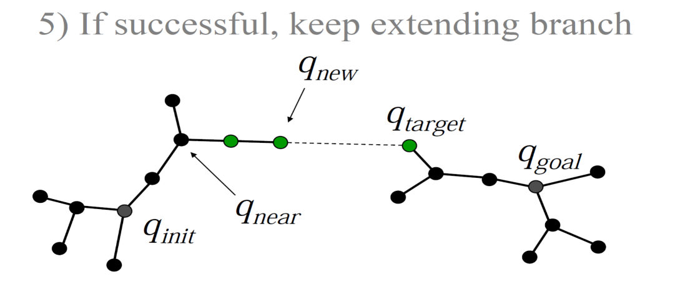
RRT step by step :
1: function RRT(Xinti,Xgoal)
2: T tree(Xinit)
3: run = true
4: while (run) do
5: Xrand getRandomState()
6: Xnearest getNearestNode(T,Xrand,hueristicMode)
7:if isVaidExpansion(Xnearest,Xrand) then
8: Xnew = goTowardNode(Xnearest,Xrand,maxEdgeLength)
9: T.addNode(Xnew,Xnearest);
10: if goalReached(Xnew,Xgoal) then
11: run = false
12: return T

Slide 13
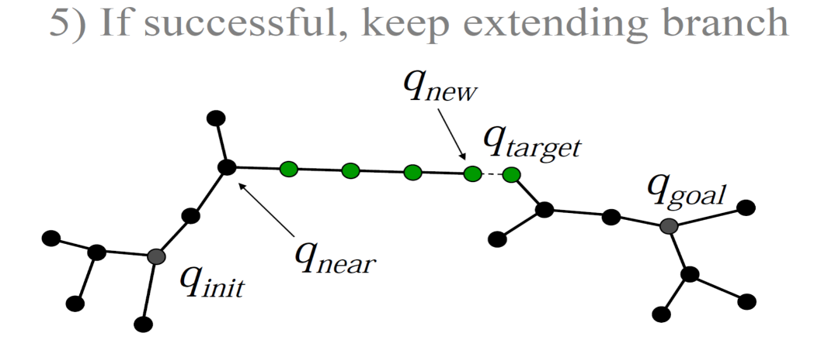
RRT step by step :
1: function RRT(Xinti,Xgoal)
2: T tree(Xinit)
3: run = true
4: while (run) do
5: Xrand getRandomState()
6: Xnearest getNearestNode(T,Xrand,hueristicMode)
7:if isVaidExpansion(Xnearest,Xrand) then
8: Xnew = goTowardNode(Xnearest,Xrand,maxEdgeLength)
9: T.addNode(Xnew,Xnearest);
10: if goalReached(Xnew,Xgoal) then
11: run = false
12: return T

Slide 14
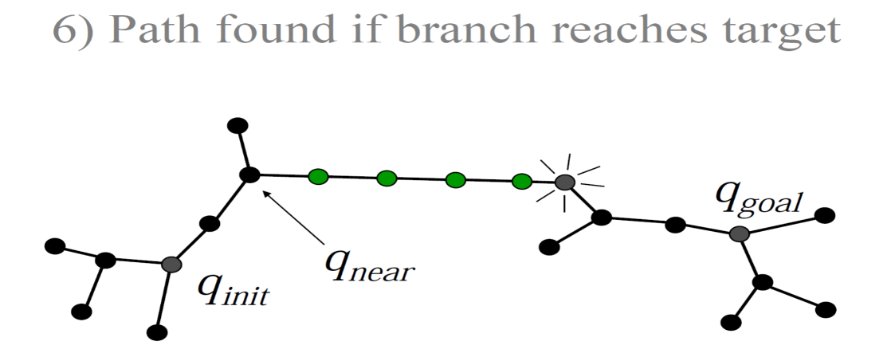
RRT step by step :
1: function RRT(Xinti,Xgoal)
2: T tree(Xinit)
3: run = true
4: while (run) do
5: Xrand getRandomState()
6: Xnearest getNearestNode(T,Xrand,hueristicMode)
7:if isVaidExpansion(Xnearest,Xrand) then
8: Xnew = goTowardNode(Xnearest,Xrand,maxEdgeLength)
9: T.addNode(Xnew,Xnearest);
10: if goalReached(Xnew,Xgoal) then
11: run = false
12: return T

Slide 15
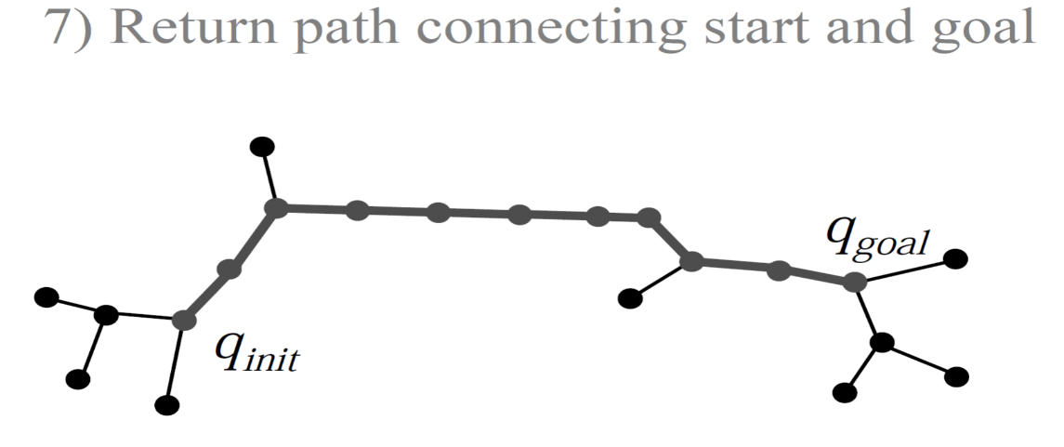
RRT step by step :
1: function RRT(Xinti,Xgoal)
2: T tree(Xinit)
3: run = true
4: while (run) do
5: Xrand getRandomState()
6: Xnearest getNearestNode(T,Xrand,hueristicMode)
7:if isVaidExpansion(Xnearest,Xrand) then
8: Xnew = goTowardNode(Xnearest,Xrand,maxEdgeLength)
9: T.addNode(Xnew,Xnearest);
10: if goalReached(Xnew,Xgoal) then
11: run = false
12: return T

Slide 16
RRT advantages
Balance between greedy search and exploration
Converges to sampling distribution in the limit

Slide 17
RRT disadvantages
Metric sensitivity
Nearest-neighbor efficiency
Unknown rate of convergence
“long tail” in computation time distribution

Slide 18
An optimized solution to RRT
RRT*

Slide 19
What is RRT*?
RRT* is a improved version of RRT algorithm that can converged to optimal solution in finite time.
So There are lots of similarities between them that we’ll discuss them below.

Slide 20
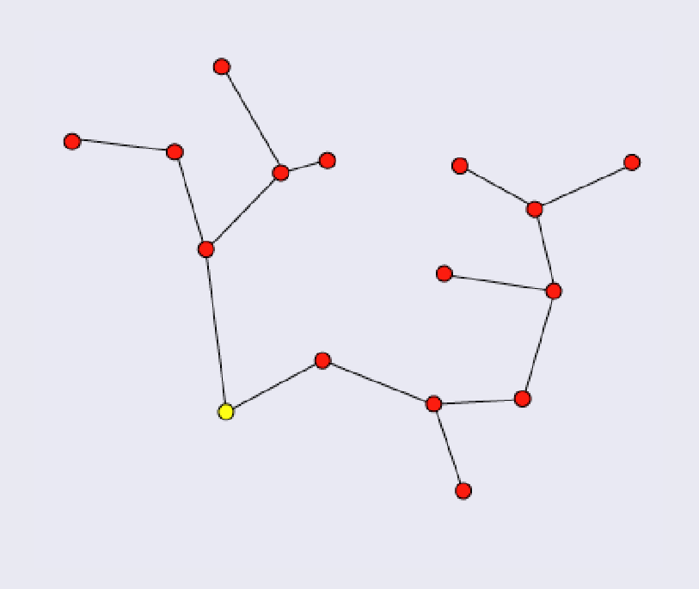
RRT* step by step
1: function RRT*(Xinit,Xgoal)
2: T tree(Xinit)
3: run true
4: iteration 0
5: while(run) do
6: Xrand getRandomState()
7: Xnearest getNearestNode(T,Xrand,hueristicMode)
8: Xnears getNearestNodes(T,Xrand,hueristicmode)
9: fore each n  Xnears do
10: if isValidExpansion(n,Xrand) then
11: Xnew = goTowardNode(Xnearest,Xrand,maxEdgeLength)
12: T.addNode(Xnew,Xnearest);
13: if goalReached(Xnew,Xgoal) then
14: return T
15: for each n  Xnears do
16: if Xnew.getPathLengthFromRoot() + distanceBetween(Xnew,n) < n.getPathLengthFromRoot() then
17: if isValidExpansion(n,Xnew) then
18: changeParent(n,Xnew)
19: iteration iteration + 1
20: if iteration = maxIteration then
21: run false

Slide 21
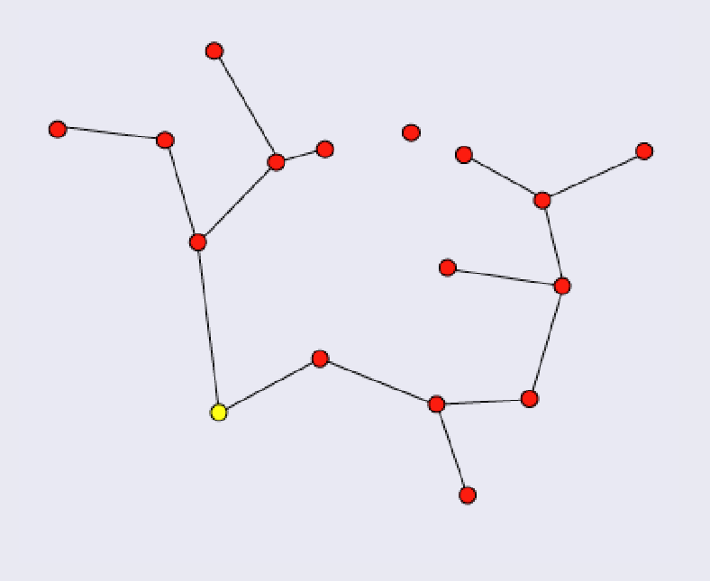
RRT* step by step
1: function RRT*(Xinit,Xgoal)
2: T tree(Xinit)
3: run true
4: iteration 0
5: while(run) do
6: Xrand getRandomState()
7: Xnearest getNearestNode(T,Xrand,hueristicMode)
8: Xnears getNearestNodes(T,Xrand,hueristicmode)
9: fore each n  Xnears do
10: if isValidExpansion(n,Xrand) then
11: Xnew = goTowardNode(Xnearest,Xrand,maxEdgeLength)
12: T.addNode(Xnew,Xnearest);
13: if goalReached(Xnew,Xgoal) then
14: return T
15: for each n  Xnears do
16: if Xnew.getPathLengthFromRoot() + distanceBetween(Xnew,n) < n.getPathLengthFromRoot() then
17: if isValidExpansion(n,Xnew) then
18: changeParent(n,Xnew)
19: iteration iteration + 1
20: if iteration = maxIteration then
21: run false

Slide 22
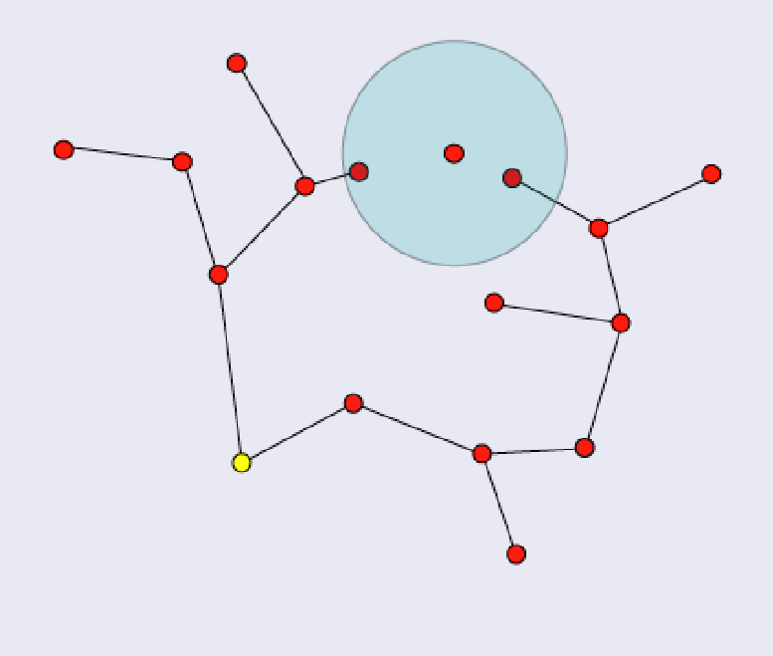
RRT* step by step
1: function RRT*(Xinit,Xgoal)
2: T tree(Xinit)
3: run true
4: iteration 0
5: while(run) do
6: Xrand getRandomState()
7: Xnearest getNearestNode(T,Xrand,hueristicMode)
8: Xnears getNearestNodes(T,Xrand,hueristicmode)
9: fore each n  Xnears do
10: if isValidExpansion(n,Xrand) then
11: Xnew = goTowardNode(Xnearest,Xrand,maxEdgeLength)
12: T.addNode(Xnew,Xnearest);
13: if goalReached(Xnew,Xgoal) then
14: return T
15: for each n  Xnears do
16: if Xnew.getPathLengthFromRoot() + distanceBetween(Xnew,n) < n.getPathLengthFromRoot() then
17: if isValidExpansion(n,Xnew) then
18: changeParent(n,Xnew)
19: iteration iteration + 1
20: if iteration = maxIteration then
21: run false

Slide 23
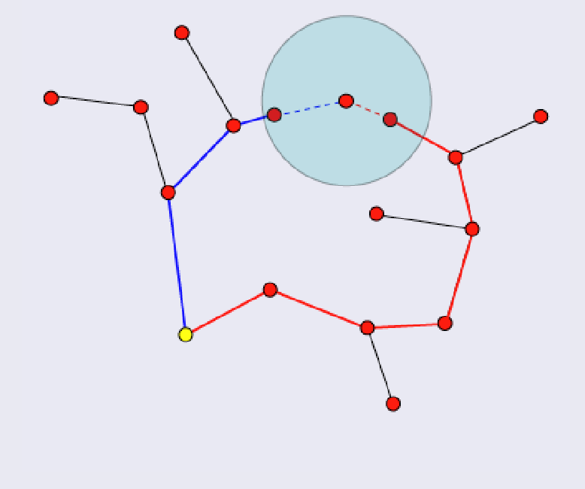
RRT* step by step
1: function RRT*(Xinit,Xgoal)
2: T tree(Xinit)
3: run true
4: iteration 0
5: while(run) do
6: Xrand getRandomState()
7: Xnearest getNearestNode(T,Xrand,hueristicMode)
8: Xnears getNearestNodes(T,Xrand,hueristicmode)
9: fore each n  Xnears do
10: if isValidExpansion(n,Xrand) then
11: Xnew = goTowardNode(Xnearest,Xrand,maxEdgeLength)
12: T.addNode(Xnew,Xnearest);
13: if goalReached(Xnew,Xgoal) then
14: return T
15: for each n  Xnears do
16: if Xnew.getPathLengthFromRoot() + distanceBetween(Xnew,n) < n.getPathLengthFromRoot() then
17: if isValidExpansion(n,Xnew) then
18: changeParent(n,Xnew)
19: iteration iteration + 1
20: if iteration = maxIteration then
21: run false

Slide 24
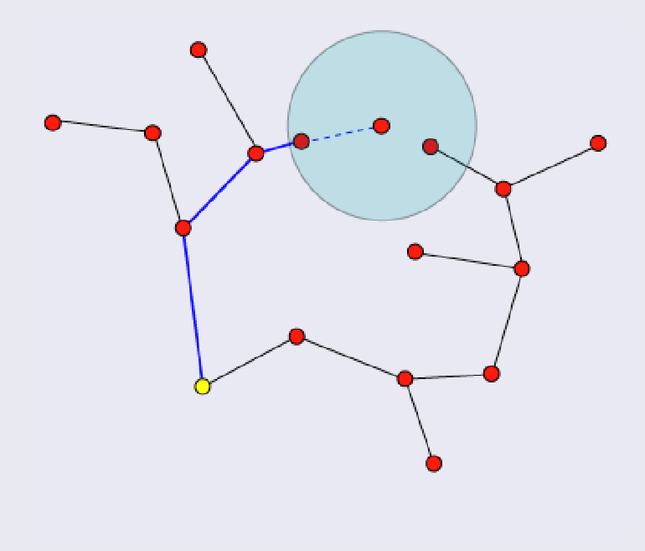
RRT* step by step
1: function RRT*(Xinit,Xgoal)
2: T tree(Xinit)
3: run true
4: iteration 0
5: while(run) do
6: Xrand getRandomState()
7: Xnearest getNearestNode(T,Xrand,hueristicMode)
8: Xnears getNearestNodes(T,Xrand,hueristicmode)
9: fore each n  Xnears do
10: if isValidExpansion(n,Xrand) then
11: Xnew = goTowardNode(Xnearest,Xrand,maxEdgeLength)
12: T.addNode(Xnew,Xnearest);
13: if goalReached(Xnew,Xgoal) then
14: return T
15: for each n  Xnears do
16: if Xnew.getPathLengthFromRoot() + distanceBetween(Xnew,n) < n.getPathLengthFromRoot() then
17: if isValidExpansion(n,Xnew) then
18: changeParent(n,Xnew)
19: iteration iteration + 1
20: if iteration = maxIteration then
21: run false

Slide 25
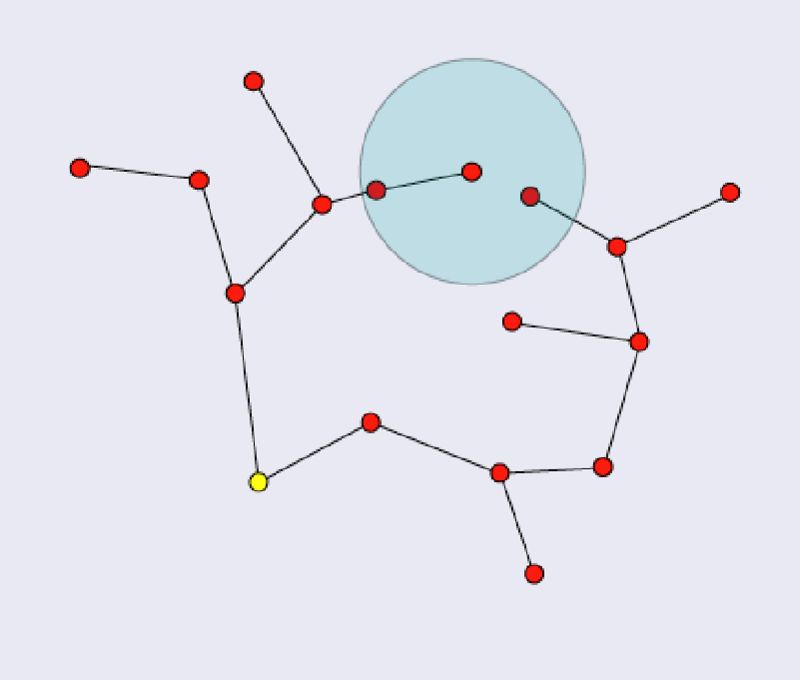
RRT* step by step
1: function RRT*(Xinit,Xgoal)
2: T tree(Xinit)
3: run true
4: iteration 0
5: while(run) do
6: Xrand getRandomState()
7: Xnearest getNearestNode(T,Xrand,hueristicMode)
8: Xnears getNearestNodes(T,Xrand,hueristicmode)
9: fore each n  Xnears do
10: if isValidExpansion(n,Xrand) then
11: Xnew = goTowardNode(Xnearest,Xrand,maxEdgeLength)
12: T.addNode(Xnew,Xnearest);
13: if goalReached(Xnew,Xgoal) then
14: return T
15: for each n  Xnears do
16: if Xnew.getPathLengthFromRoot() + distanceBetween(Xnew,n) < n.getPathLengthFromRoot() then
17: if isValidExpansion(n,Xnew) then
18: changeParent(n,Xnew)
19: iteration iteration + 1
20: if iteration = maxIteration then
21: run false

Slide 26
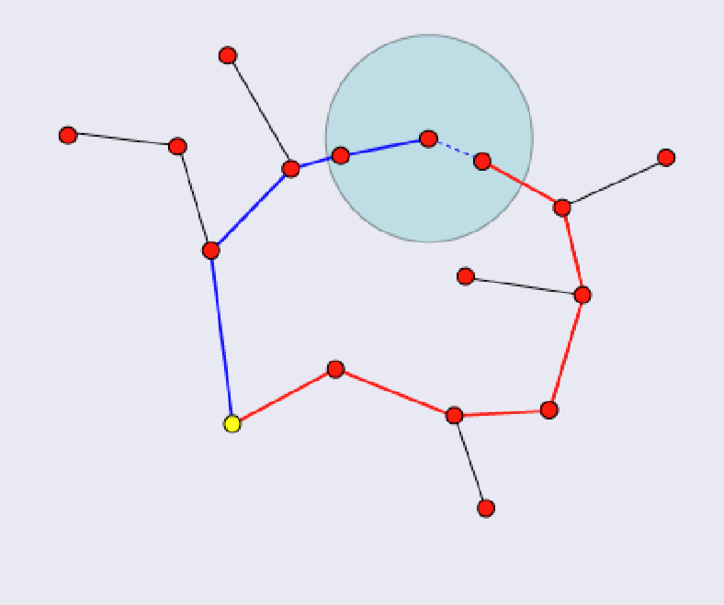
RRT* step by step
1: function RRT*(Xinit,Xgoal)
2: T tree(Xinit)
3: run true
4: iteration 0
5: while(run) do
6: Xrand getRandomState()
7: Xnearest getNearestNode(T,Xrand,hueristicMode)
8: Xnears getNearestNodes(T,Xrand,hueristicmode)
9: fore each n  Xnears do
10: if isValidExpansion(n,Xrand) then
11: Xnew = goTowardNode(Xnearest,Xrand,maxEdgeLength)
12: T.addNode(Xnew,Xnearest);
13: if goalReached(Xnew,Xgoal) then
14: return T
15: for each n  Xnears do
16: if Xnew.getPathLengthFromRoot() + distanceBetween(Xnew,n) < n.getPathLengthFromRoot() then
17: if isValidExpansion(n,Xnew) then
18: changeParent(n,Xnew)
19: iteration iteration + 1
20: if iteration = maxIteration then
21: run false

Slide 27
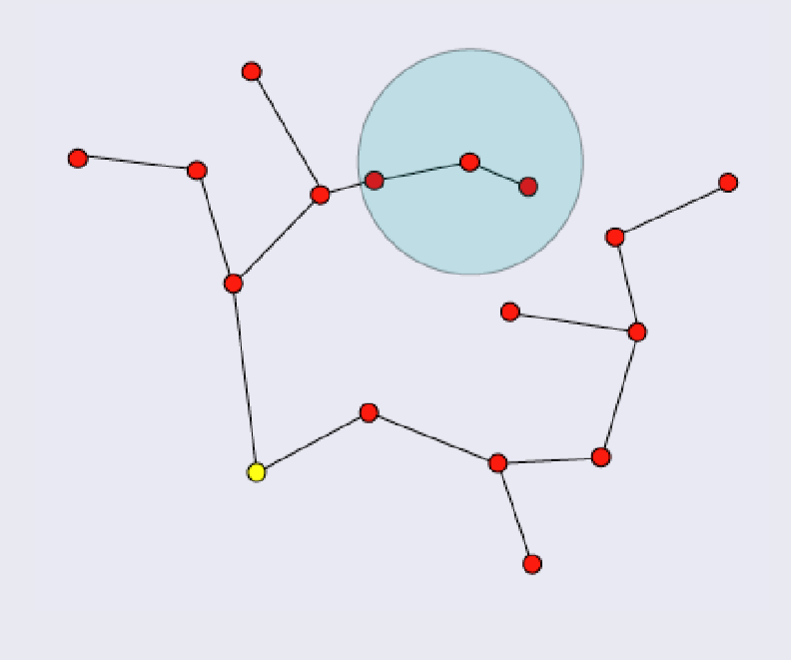
RRT* step by step
1: function RRT*(Xinit,Xgoal)
2: T tree(Xinit)
3: run true
4: iteration 0
5: while(run) do
6: Xrand getRandomState()
7: Xnearest getNearestNode(T,Xrand,hueristicMode)
8: Xnears getNearestNodes(T,Xrand,hueristicmode)
9: fore each n  Xnears do
10: if isValidExpansion(n,Xrand) then
11: Xnew = goTowardNode(Xnearest,Xrand,maxEdgeLength)
12: T.addNode(Xnew,Xnearest);
13: if goalReached(Xnew,Xgoal) then
14: return T
15: for each n  Xnears do
16: if Xnew.getPathLengthFromRoot() + distanceBetween(Xnew,n) < n.getPathLengthFromRoot() then
17: if isValidExpansion(n,Xnew) then
18: changeParent(n,Xnew)
19: iteration iteration + 1
20: if iteration = maxIteration then
21: run false

Slide 28
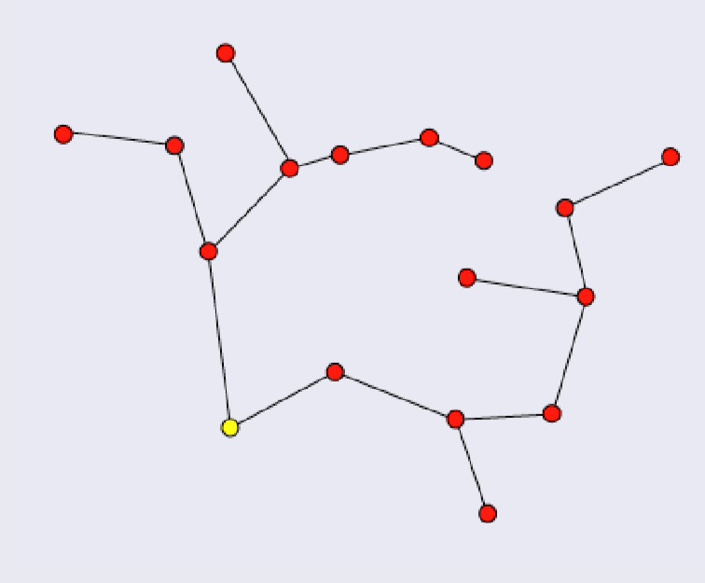
RRT* step by step
1: function RRT*(Xinit,Xgoal)
2: T tree(Xinit)
3: run true
4: iteration 0
5: while(run) do
6: Xrand getRandomState()
7: Xnearest getNearestNode(T,Xrand,hueristicMode)
8: Xnears getNearestNodes(T,Xrand,hueristicmode)
9: fore each n  Xnears do
10: if isValidExpansion(n,Xrand) then
11: Xnew = goTowardNode(Xnearest,Xrand,maxEdgeLength)
12: T.addNode(Xnew,Xnearest);
13: if goalReached(Xnew,Xgoal) then
14: return T
15: for each n  Xnears do
16: if Xnew.getPathLengthFromRoot() + distanceBetween(Xnew,n) < n.getPathLengthFromRoot() then
17: if isValidExpansion(n,Xnew) then
18: changeParent(n,Xnew)
19: iteration iteration + 1
20: if iteration = maxIteration then
21: run false

Slide 29
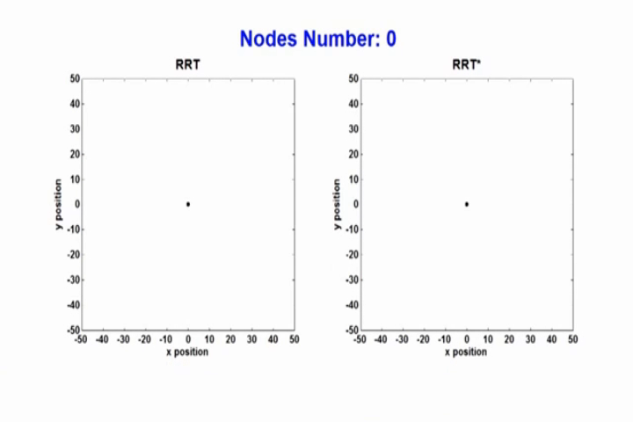
RRT* vs RRT

Slide 30
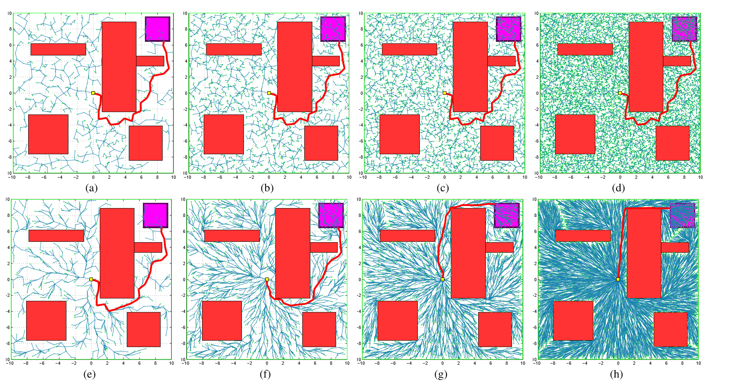
RRT* vs RRT

Slide 31
References :
Users.wpi.edu
Rapidly Exploring Random Tree Algorithm (RRT) by Ryan chow
Robotic motion planning by robotics institute:
www.cs.cmu.edu
en.wikipedia.org/wiki/Rapidly- exploring_random_tree
PRM,RRT,RRT* by Frank Dellaert
- مقایسه الگوریتم‌‌های RRT* وA* برای مسیریابی حرکت روبات متحرک
در محیط‌های پیچیده دو بعدی (اعظم موسویان / پوریا لاجوردی / محمدرضا اصغری اسکویی)

Slide 32
Click here to see our implementation

Slide 33
Thanks for your time

